Slide 1
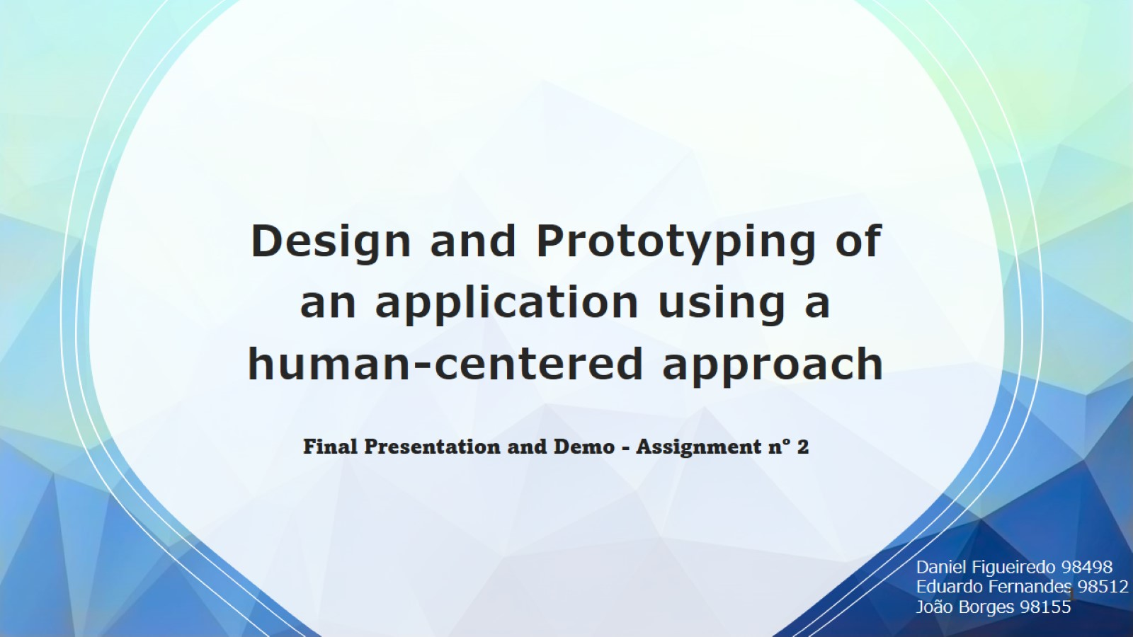
Design and Prototyping of an application using a human-centered approach

Slide 2
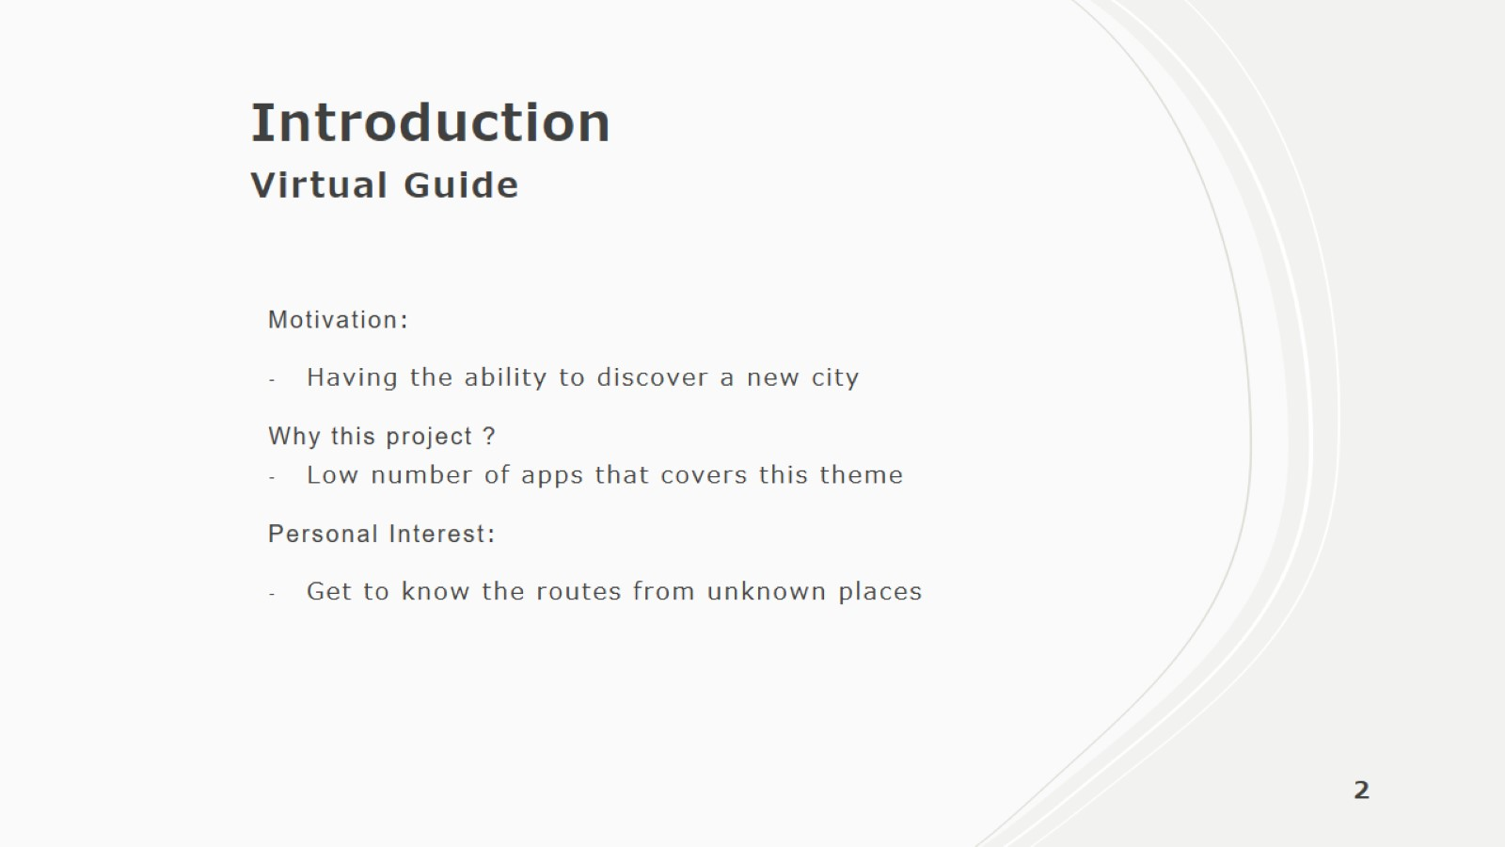
Introduction Virtual Guide

Slide 3
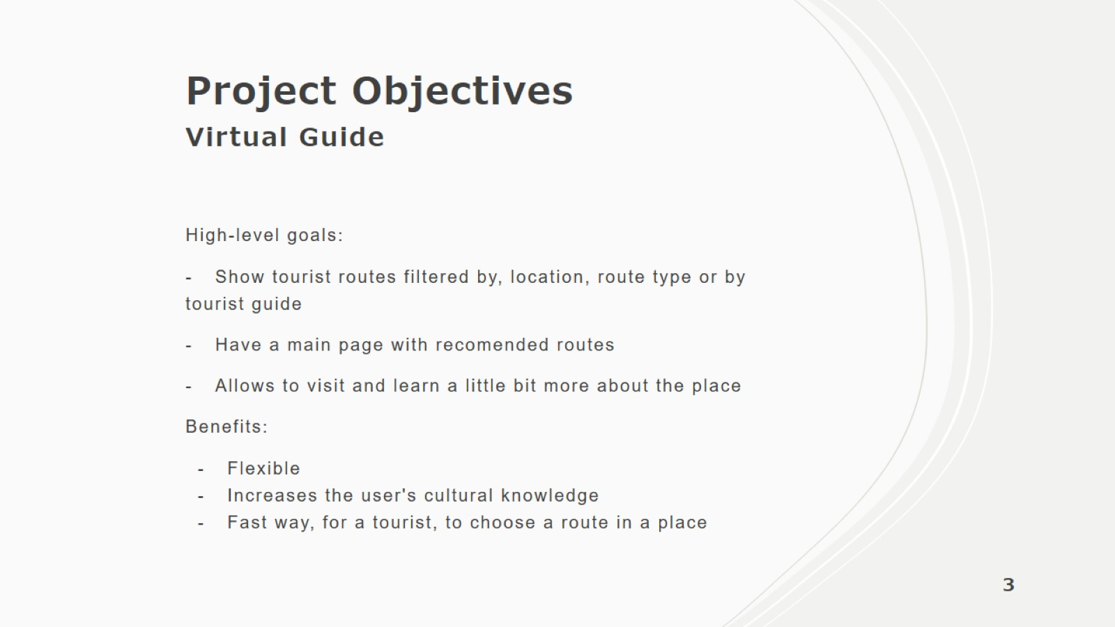
Project Objectives Virtual Guide

Slide 4

Personas Virtual Guide

Slide 5
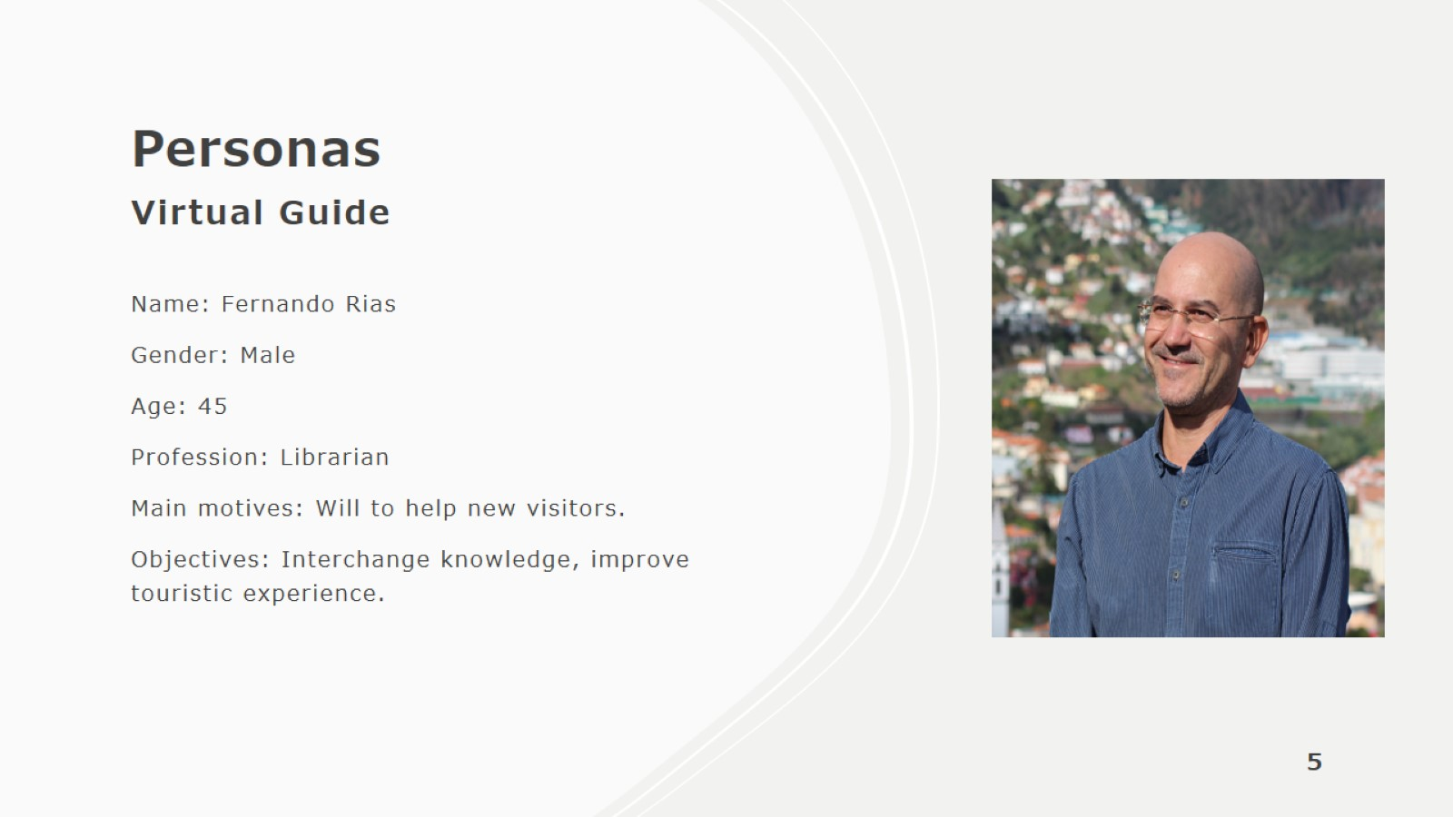
Personas Virtual Guide

Slide 6
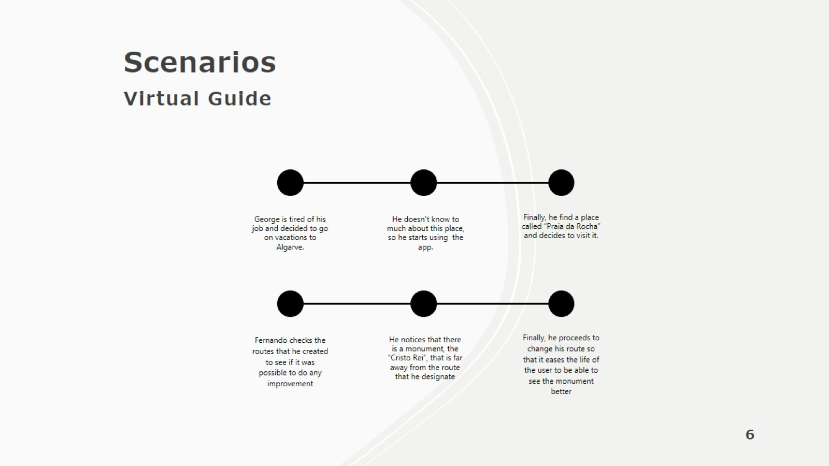

Slide 7
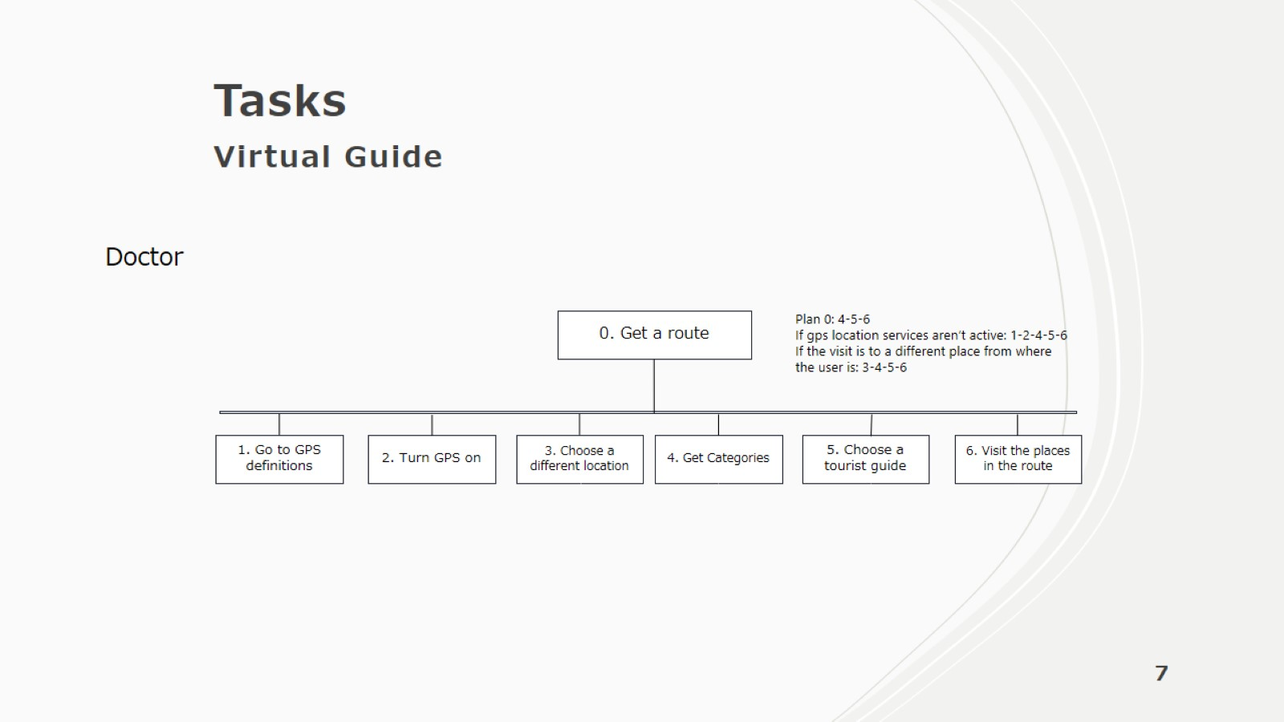
Tasks Virtual Guide

Slide 8
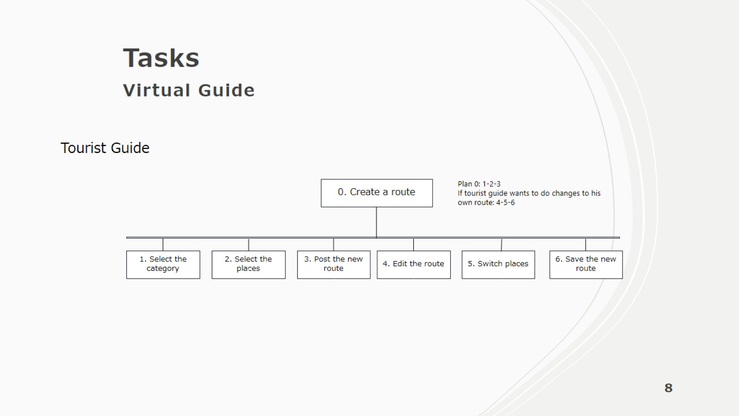
Tasks Virtual Guide

Slide 9
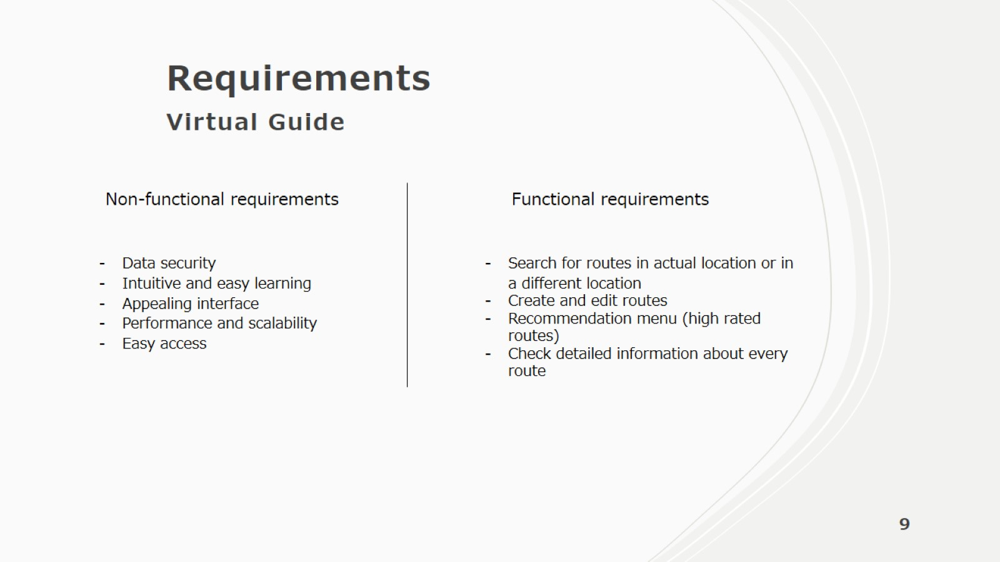
Requirements Virtual Guide

Slide 10
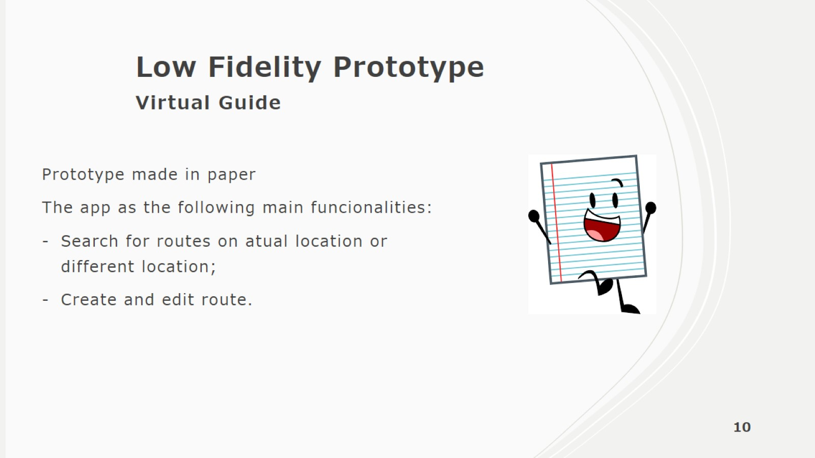
Low Fidelity Prototype Virtual Guide

Slide 11
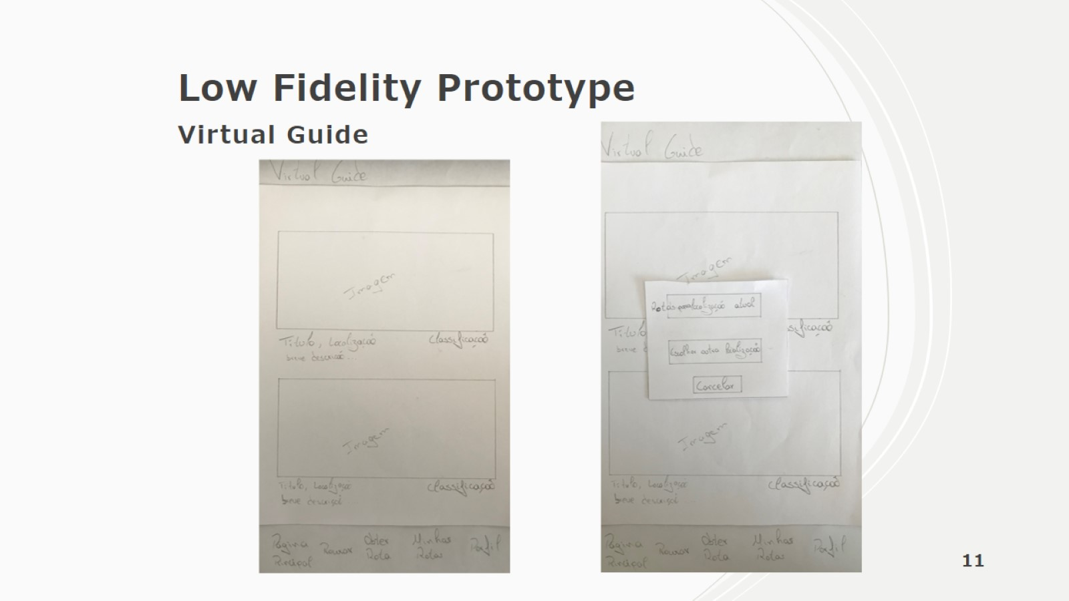
Low Fidelity Prototype Virtual Guide

Slide 12
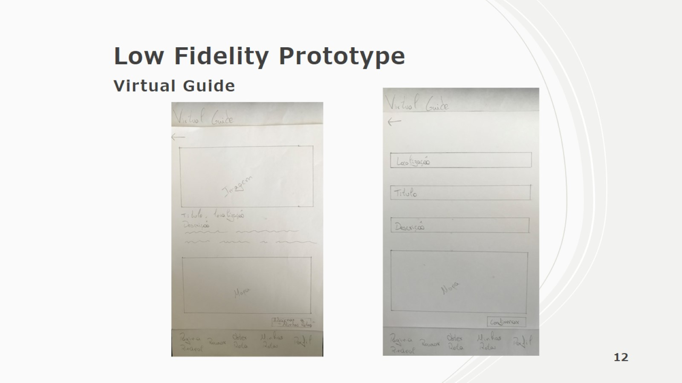
Low Fidelity Prototype Virtual Guide

Slide 13
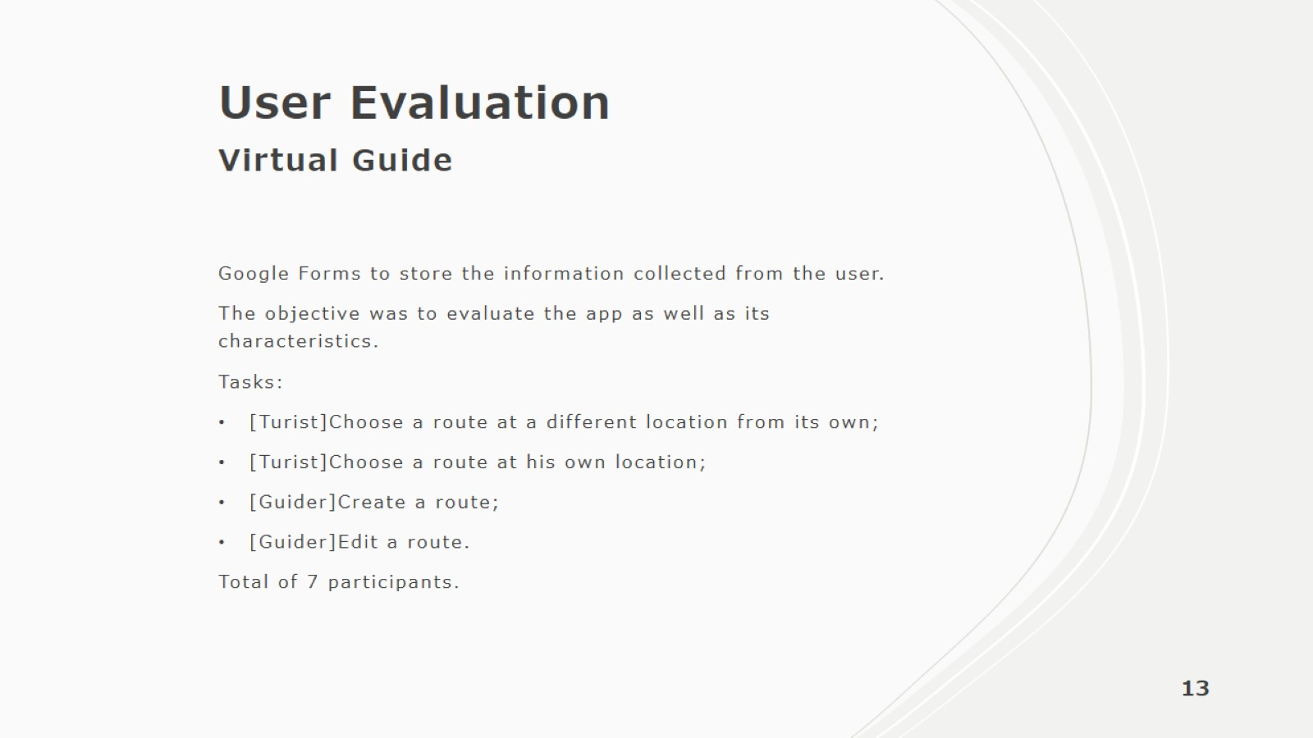
User Evaluation Virtual Guide

Slide 14
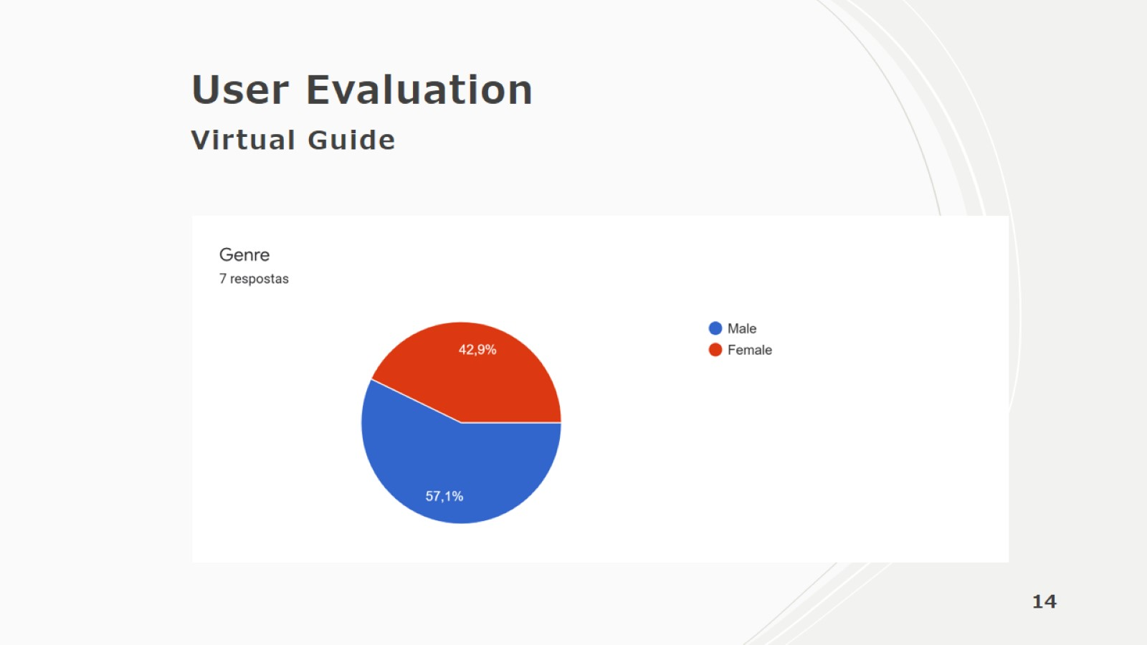
User Evaluation Virtual Guide

Slide 15
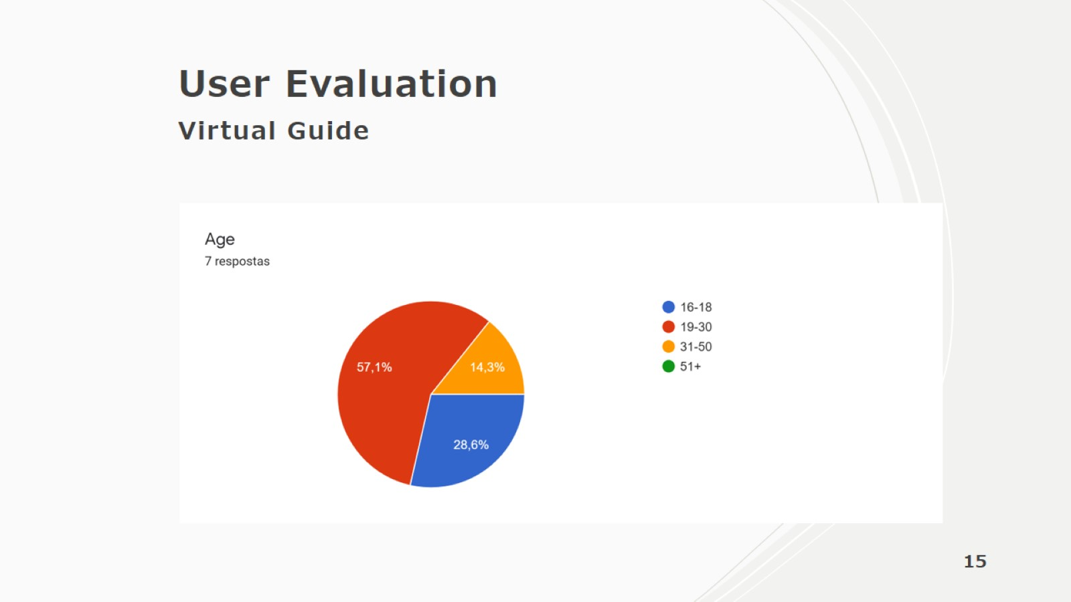
User Evaluation Virtual Guide

Slide 16
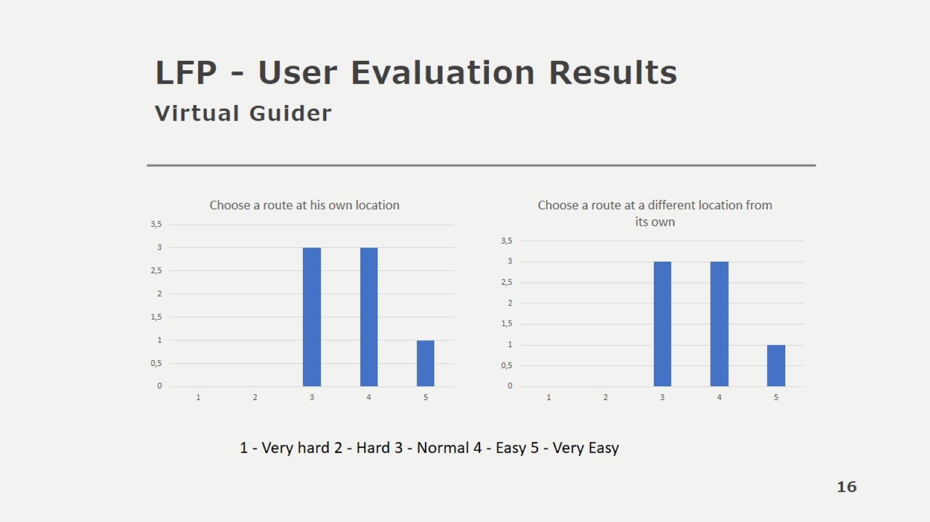
LFP - User Evaluation Results Virtual Guider

Slide 17
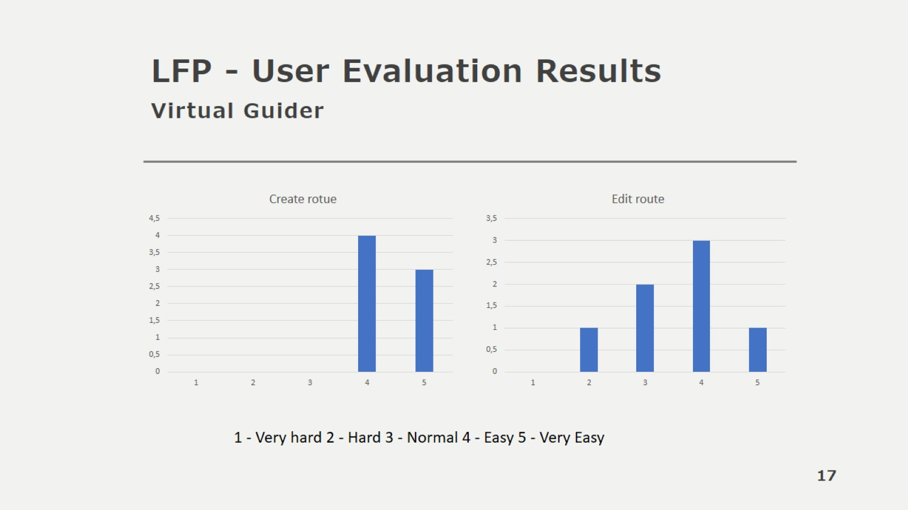
LFP - User Evaluation Results Virtual Guider

Slide 18
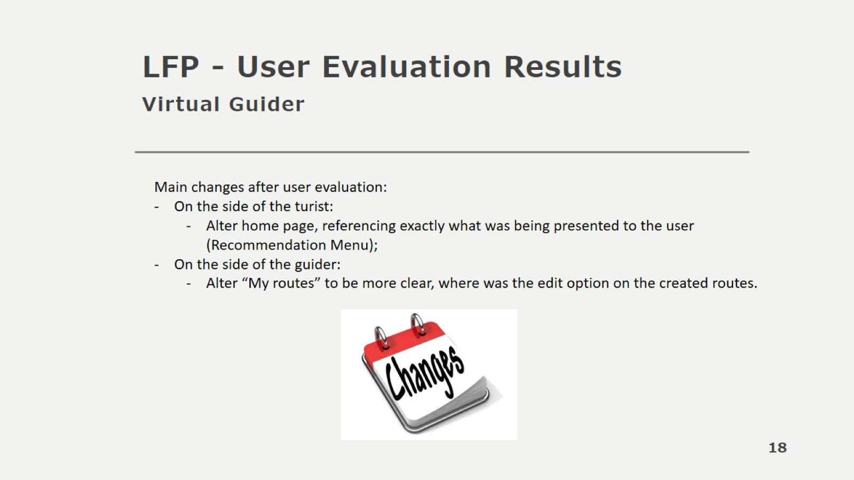
LFP - User Evaluation Results Virtual Guider

Slide 19
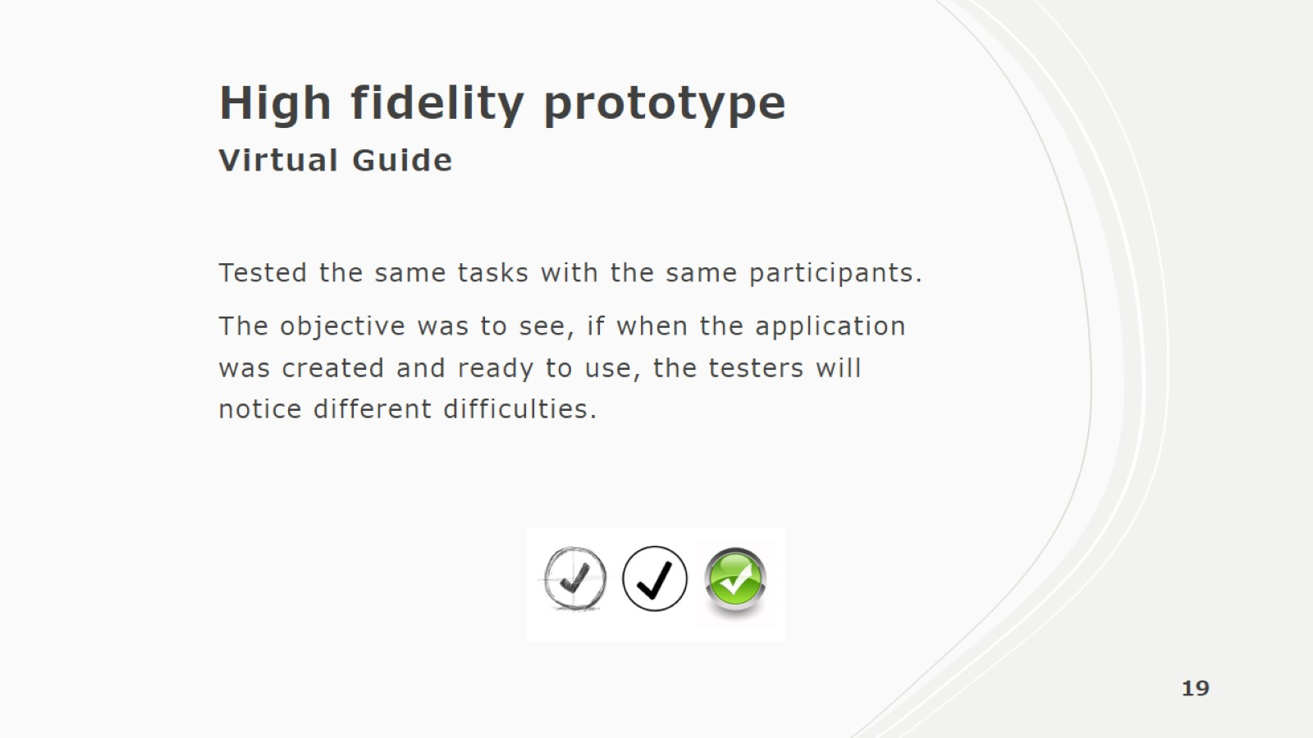
High fidelity prototype Virtual Guide

Slide 20
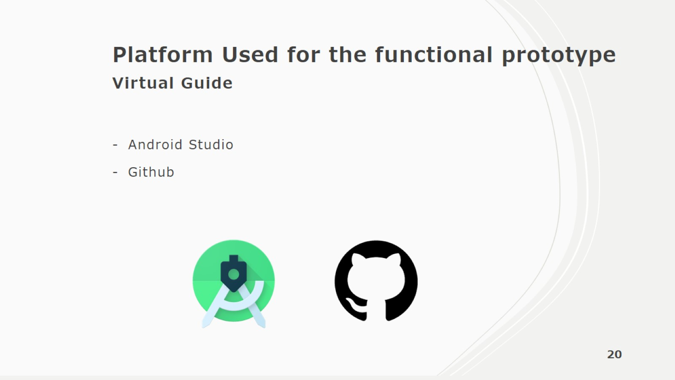
Platform Used for the functional prototype Virtual Guide

Slide 21
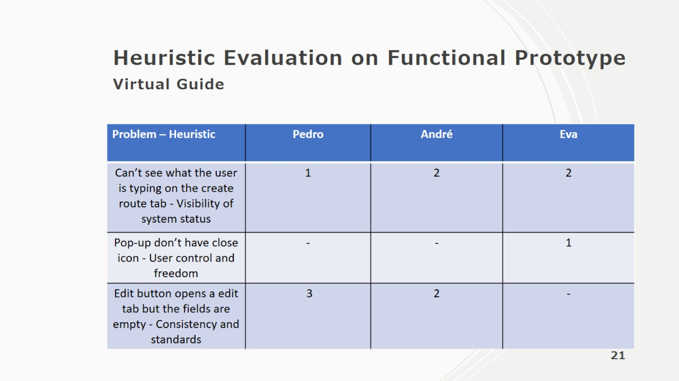
Heuristic Evaluation on Functional Prototype Virtual Guide

Slide 22


Slide 23
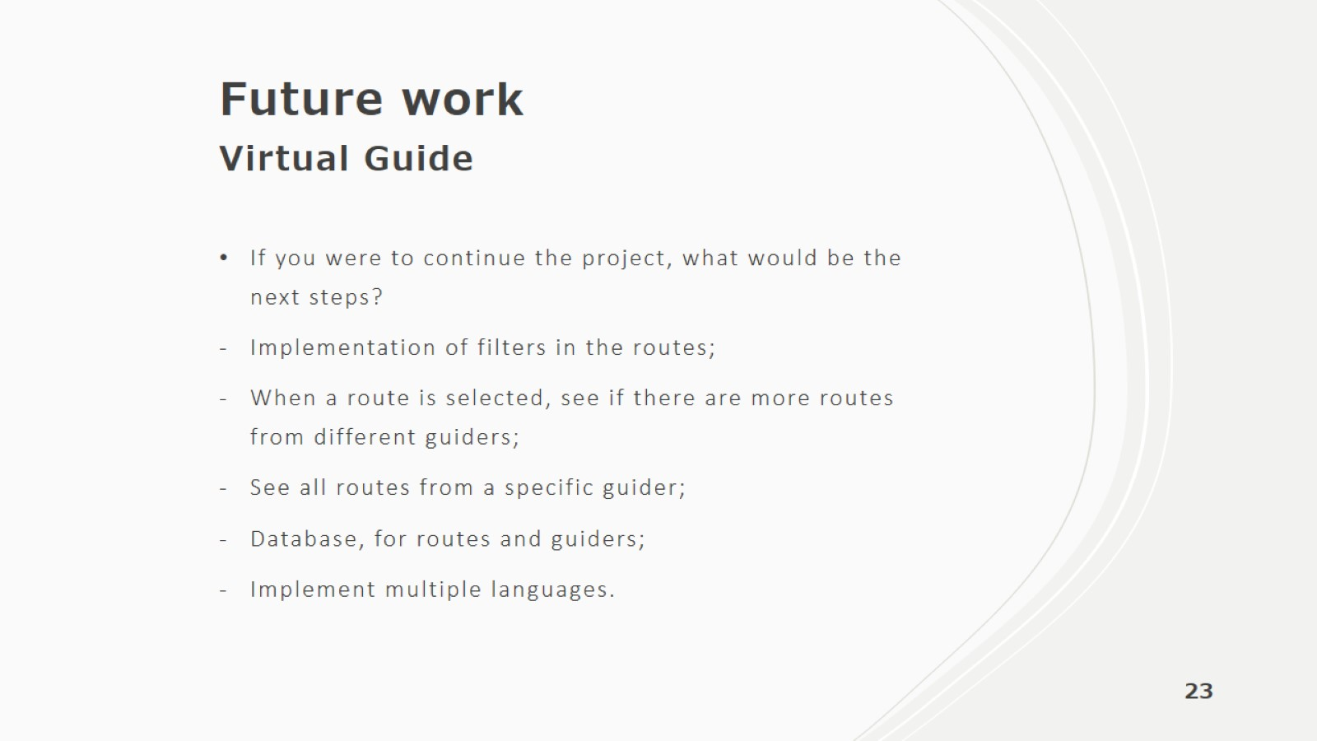
Future work Virtual Guide

Slide 24
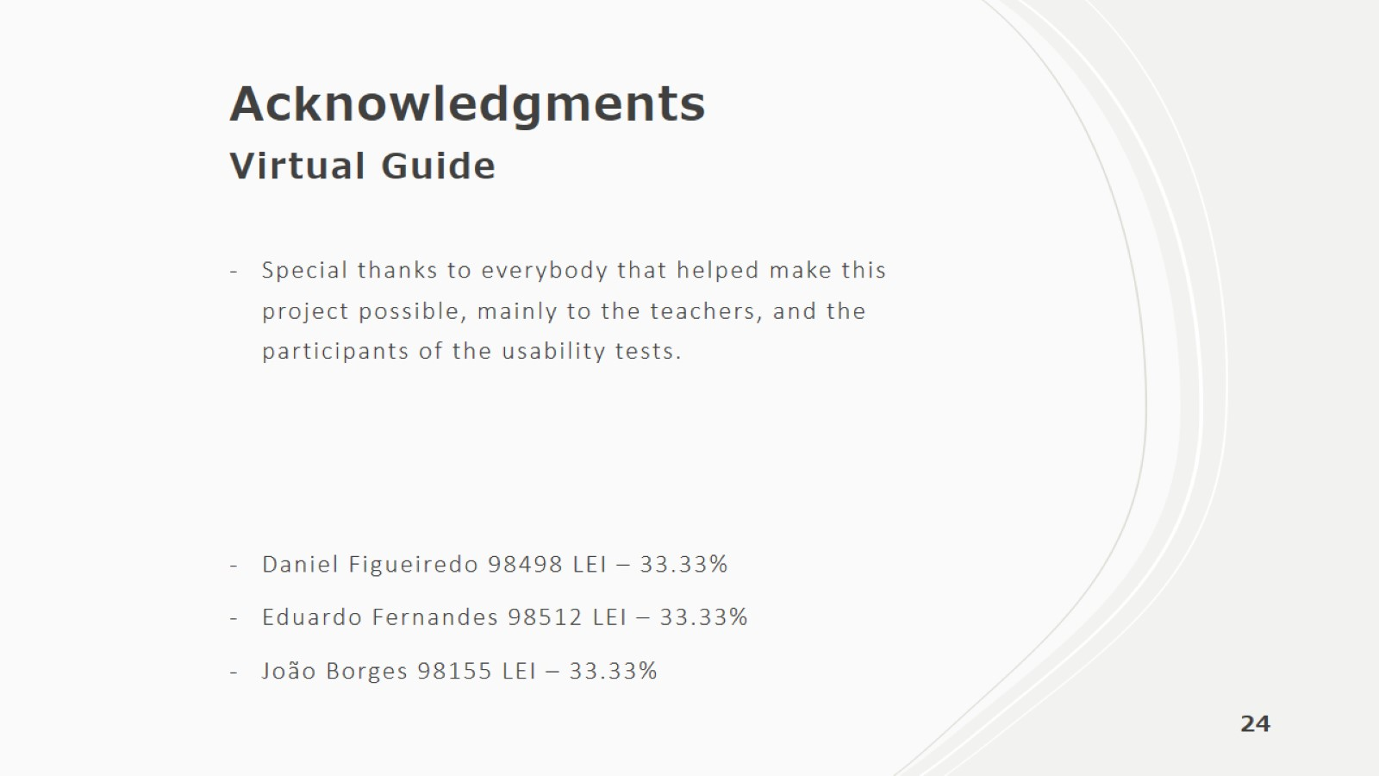
Acknowledgments Virtual Guide

